Slide 1
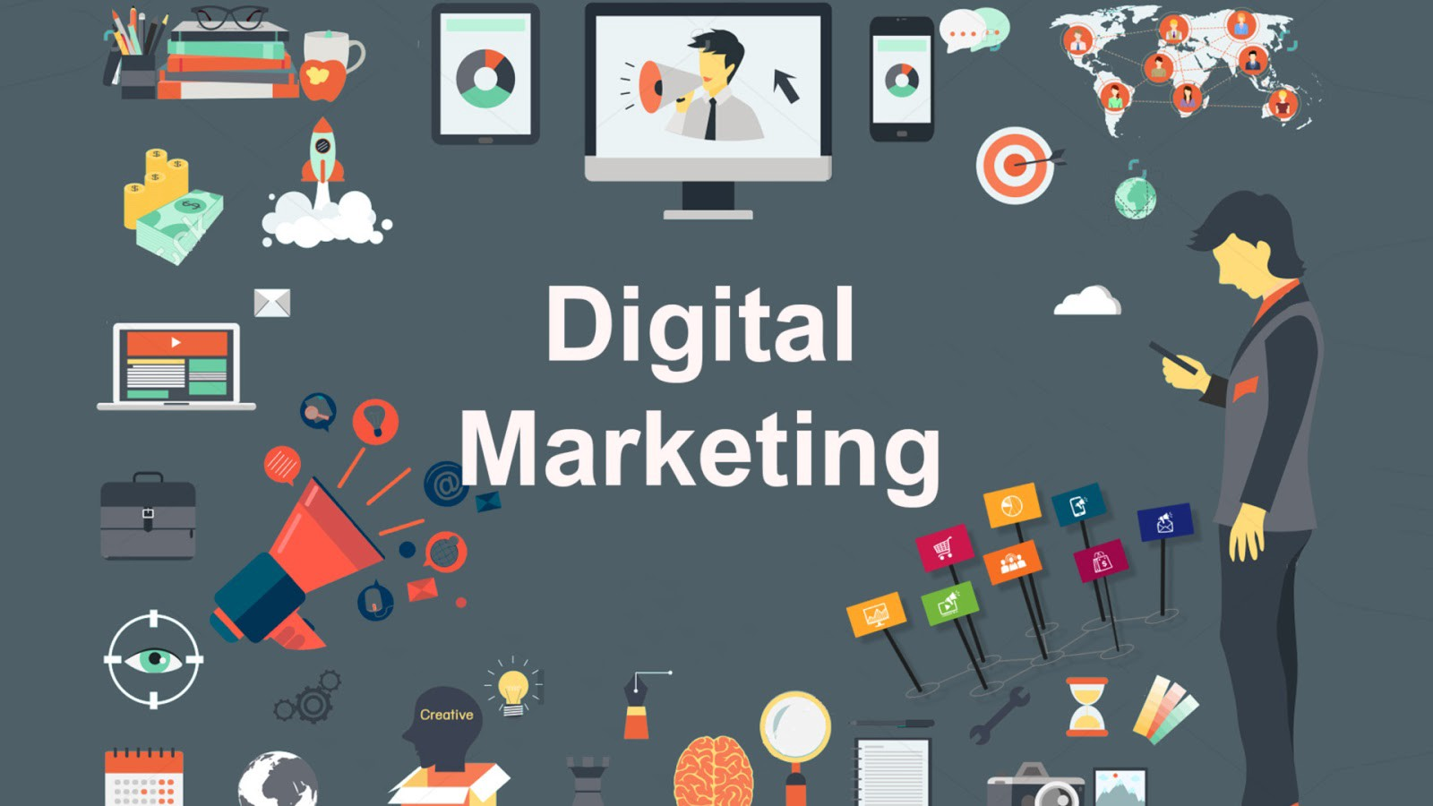

PPT ON
DIGITAL MARKETING

Slide 2
KEYPOINTS
◆ What is digital marketing
◆ Benefits of digital marketing
◆ What does digital marketing consist of
◆ SEO
◆ PPC
◆ SMM
◆ Content writing
◆ Digital marketing measurement

Slide 3

DEFINITION
◆ Digital marketing is an umbrella term for the marketing of products or services using digital technologies, mainly on the Internet, but also including mobile phones, display advertising, and any other digital medium.

Slide 4
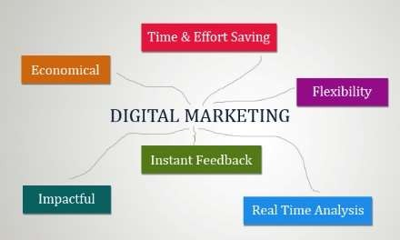
BENEFITS OF DIGITAL MARKETING

Slide 5

OBJECTIVE
◆ Reach the right audience
◆ Engage with your audience
◆ Motivate your audience to take your action
◆ Maximize return on investment(ROI)

Slide 6
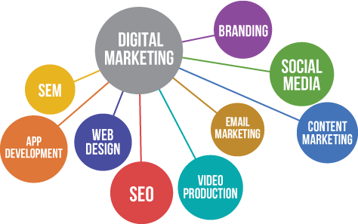
DIGITAL MARKETING CONSIST OF

Slide 7
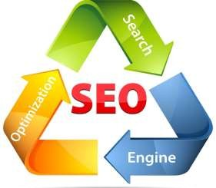
WHAT IS SEO
◆ Whenever you enter a query in a search engine and hit 'enter' you get a list of web results that contain that query term. Users normally tend to visit websites that are at the top of this list as they perceive those to be more relevant to the query. If you have ever wondered why some of these websites rank better than the others then you must know that it is because of a powerful web marketing technique called Search Engine Optimization (SEO).

Slide 8
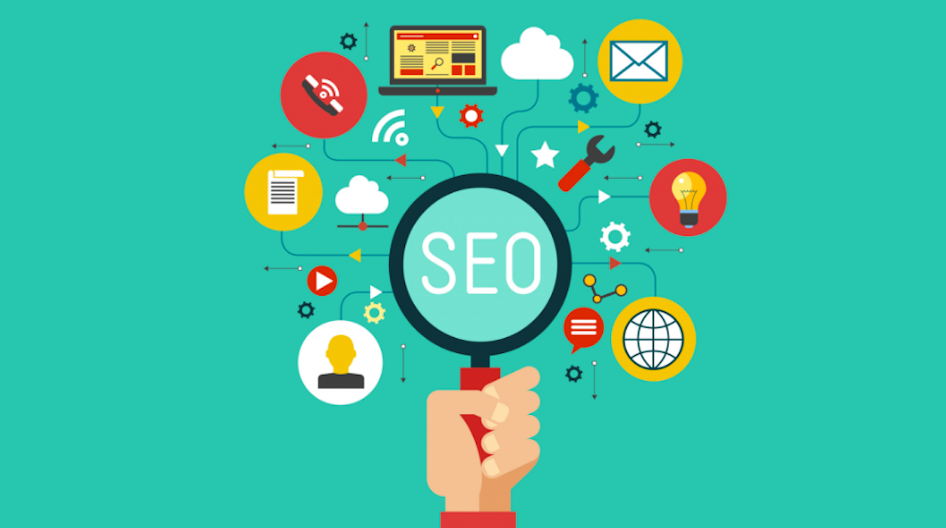
SEARCH ENGINE OPTIMIZATION

Slide 9
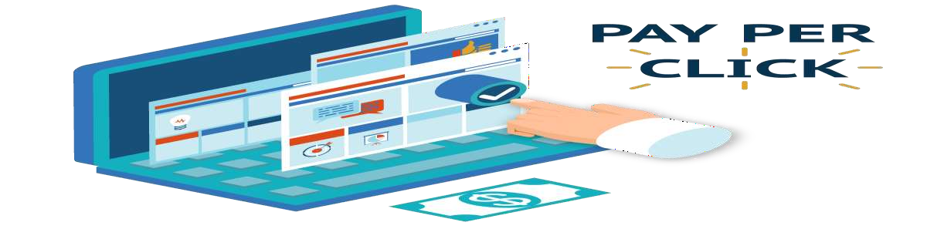
PPC(PAY PER CLICK)
◆ What is PPC (pay-per-click) marketing? Pay-per-click marketing is a way of using search engine advertising to generate clicks to your website, rather than “earning” those clicks organically

Slide 10
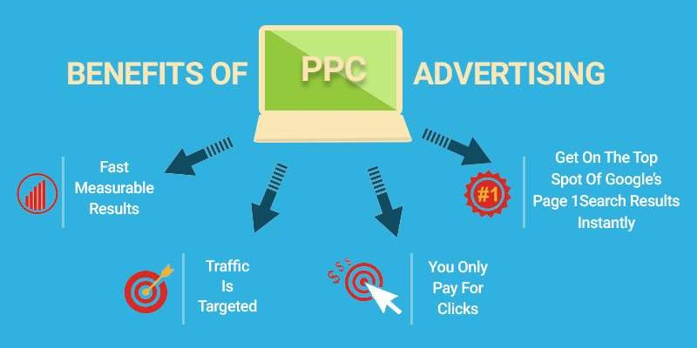
ADVANTAGE OF PPC

Slide 11
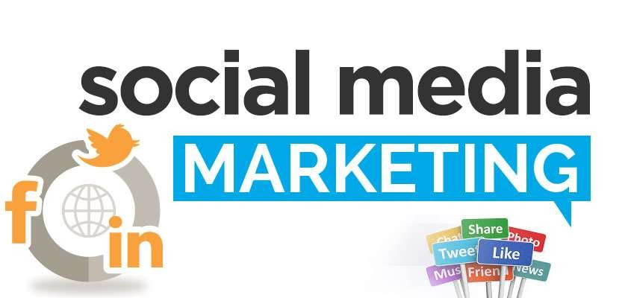
WHAT IS SMM
◆ Social media marketing (SMM) is a form of Internet marketing that utilizes social networking websites as a marketing tool. The goal of SMM is to produce content that users will share with their social network to help a company increase brand exposure and broaden customer reach.

Slide 12
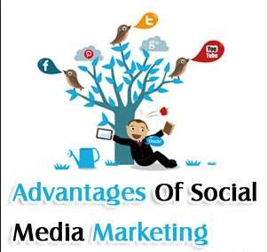
ADVANTAGE OF SMM
◆ Increased Brand Awareness
◆ More Inbound Traffic
◆ Improved Search Engine Rankings
◆ Higher Conversion Rates
◆ Better Customer Satisfaction
◆ Improved Brand Loyalty
◆ More Brand Authority

Slide 13

DISADVANTAGE OF SMM
◆ Negative feedback
◆ Potential for embarrassment
◆ Time intensive

Slide 14
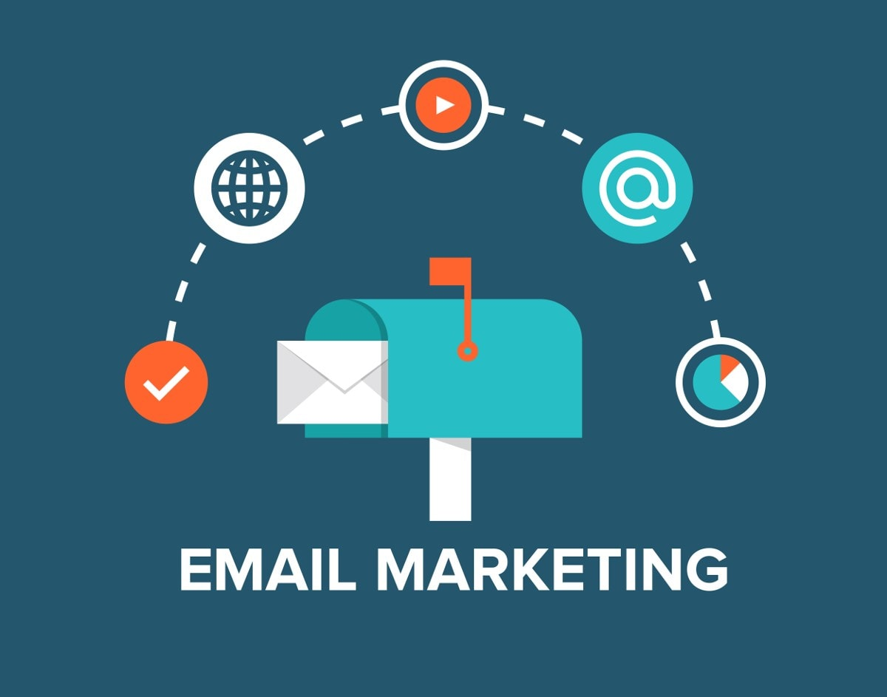
EMAIL MARKETING

Slide 15

CONTENT WRITING
◆ A website content writer or web content writer is a person who specializes in providing relevant content for websites. Every website has a specific target audience and requires a different type and level of content.

Slide 16
ADVANTAGES AND DISADVANTAGES
◆ You can get a lot of work
◆ You’ll get disciplined
◆ The rates are poor
◆ It’s ghostwriting
◆ It’s addictive
◆ You can practice alot

Slide 17
DIGITAL MARKETING AREAS
◆ SEO (Search Engine Optimization)
◆ SMO (Social Media Optimization)
◆ SEM (Search Engine Marketing)
◆ SMM(Social Media Marketing)

Slide 18
Benefits of Online Marketing over Offline Marketing
◆ High return on investment (ROI) through Online Marketing.
◆ Target only most interesting audience, pay only
◆ You can start without spending with small amount.
◆ Advertising your products on specific hours, time or day bases.
◆ Fully Controlled as per your location, budget and time.

Slide 19
CONCLUSION
◆ The study started with the aim to analyse the different issues related to the digital marketing. Based on the discussion it has been found that in case of the digital marketing the most important aspect is to connect with the users. The ladder of engagement has shown the approaches to attach with the customers. The study has also revealed that in order to utilise the digital marketing in an effective way, the companies are required to design an effective platform. With the example of Pinterest the effectiveness of a social media platform has been discussed. The current trends in the digital marketing have also been discussed in the study

Slide 20


